Slide 1

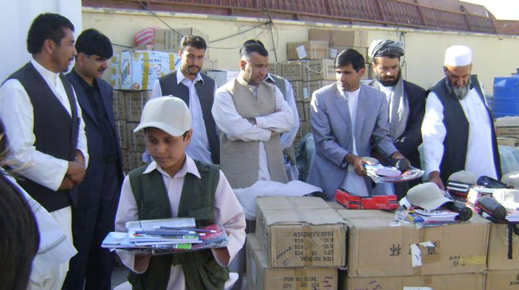
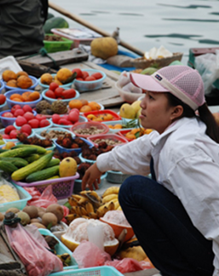
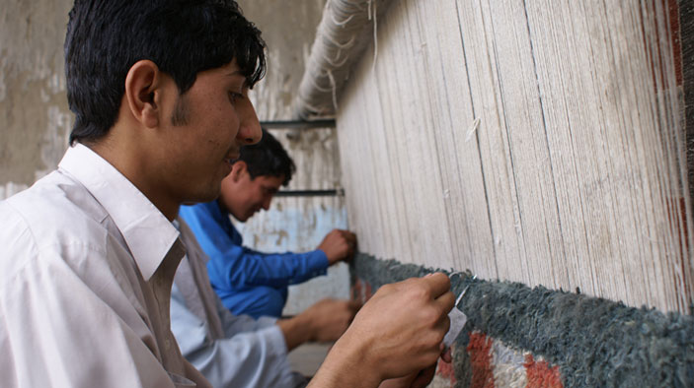
Annual Ethics Training (2017)
Last updated June, 2017
Notes:
Welcome everyone to the session.
Ask people to make sure they sign the sign-in sheet so they can receive credit for attending this refresher
A common bond that holds DAI together is our commitment to doing what’s right. It’s important to our success in development and it represents DAI and how we see ourselves – and how others see us. We accomplish this by increasing our awareness of possible ethics issues and our willingness to raise these concerns and quickly address them. The annual ethics training is essential to meeting this expectation.
All DAI staff are required to take this training by July 31st. The training is more discussion-oriented this year, designed for Managers, Chiefs of Parties and Team Leaders or their deputies to lead the session(s).
The case studies to be discussed are drawn from actual incidents.
The sessions will last between 60-90 minutes depending on the size of the group.

Slide 2

Agenda
Review of DAI’s Business Code of Conduct
Conversation Starters
Large group discussion
Scenarios
Small group discussion
Report back to large group
Notes:
Our goal for this session is to reinforce awareness and expectation to raise issues – and most importantly, increase our comfort level in discussing ethics and raising issues.
Review the agenda: To meet our goal we will …
Review DAI’s Business Code of Conduct
Being with some conversation starters
Next I will split you in to small groups where you will have longer scenarios to address and then report back to the large group on what you think

Slide 3
DAI’s Code of Business Conduct and Ethics

Slide 4

DAI's Code of Business Conduct and Ethics
Corporate Values
Integrity
Responsibility
Excellence
Global Citizenship
www.dai-global-conduct.com
Notes:
Lead a brief review of DAI’s Code of Business Conduct and Ethics
Remind participants that this is our guiding document on ethics and can be found at www.dai-global-conduct.com
The document is available in the following languages: English, Dari, Pashto, Spanish, French, Arabic. Urdu, and Bahasa Indonesia
If participants need more information on DAI’s Code of Business Conduct and Ethics they can visit the website at www.dai-global-conduct.com OR take the online “Ethics Training” available via iLearn

Slide 5
Conversation
Starters
Notes:
The idea of this portion of the session is to serve as a quick review of issues addressed in the Code of Business Conduct and Ethics.

Slide 6

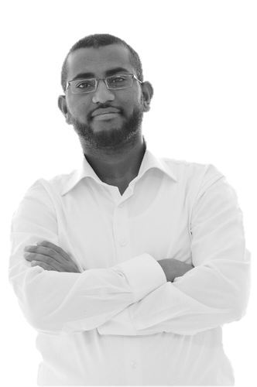
A District Official:
“I’m eager to support your work here in our District. It is also important that DAI support our local talent. My nephew just graduated from business school and is looking for a job.”
Notes:
Goal of this scenario is to get people talking about a possible conflict of interest and provide them with responses they can use when faced with a situation like this.
Read out loud (or ask for a volunteer to read out loud) the scenario on the screen
Ask the large group to respond to the scenario:
Do you think there is an issue here?
How would you respond?

Slide 7
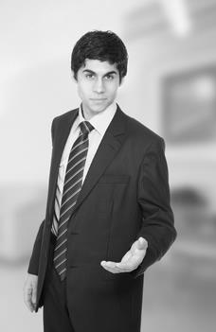
A hotel clerk:
“Here’s the receipt you can use for your travel voucher. Everyone does it. Just give me a few dollars.”
Notes:
Goal of this scenario is to get people talking about a possible act of fraud and provide them with responses they can use when faced with a situation like this.
Read out loud (or ask for a volunteer to read out loud) the scenario on the screen
Ask the large group to respond to the scenario:
Do you think there is an issue here?
How would you respond?

Slide 8
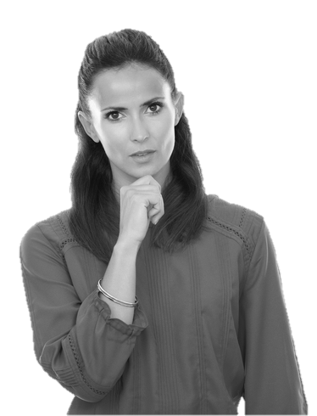

One DAI employee to another:
“I hope nobody notices the mistake. The project will be over by then.”
Notes:
Goal of this scenario is to get people talking about a code of conduct issue related to quality, professionalism and the expectation that we do our utmost. If we see a mistake, we owe up to it, fix it and make sure it doesn't happen again. Provide them with next steps they may want to take in a situation like this.
Read out loud (or ask for a volunteer to read out loud) the scenario on the screen
Ask the large group to respond to the scenario:
Do you think there is an issue here?
What could you do next?

Slide 9
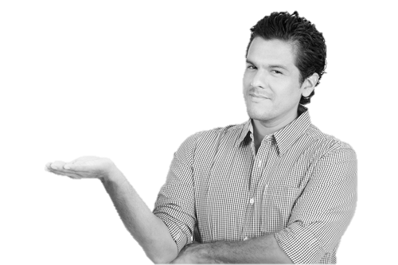
One DAI employee to another:
“Don’t tell our boss. He’ll just get upset.”
Notes:
Goal of this scenario is to get people talking about a possible code of conduct issue in a workplace in which the supervisor may not tolerate dissent and may be disrespectful to others. Provide them with responses they can use / possible next steps when faced with a situation like this.
Read out loud (or ask for a volunteer to read out loud) the scenario on the screen
Ask the large group to respond to the scenario:
Do you think there is an issue here?
How would you respond?
What would you do next?

Slide 10

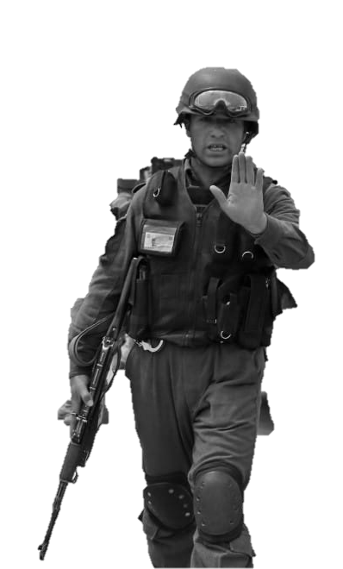
Policeman at a checkpoint:
“Step out of the vehicle. Your papers are not in order. You and your colleagues will be detained overnight unless we can sort this out.”
Notes:
Goal of this scenario is to get people to recognize that the safety of DAI employee’s is #1 and that we would expect employees to comply for safety and then immediately report any ethical violations, such as a bribe under duress, after the fact.
Read out loud (or ask for a volunteer to read out loud) the scenario on the screen
Ask the large group to respond to the scenario:
How would you respond?
What would you do next?

Slide 11
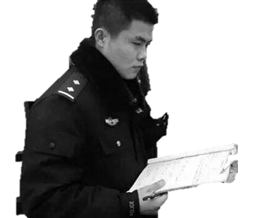
Policeman at a checkpoint:
“Do you have a few coins for tea?”
Notes:
Goal of this scenario is to get people talking about a possible bribe and provide them with responses they can use / possible next steps when faced with a situation like this.
Read out loud (or ask for a volunteer to read out loud) the scenario on the screen
Ask the large group to respond to the scenario:
Do you think there is an issue here?
How would you respond?
What would you do next?

Slide 12
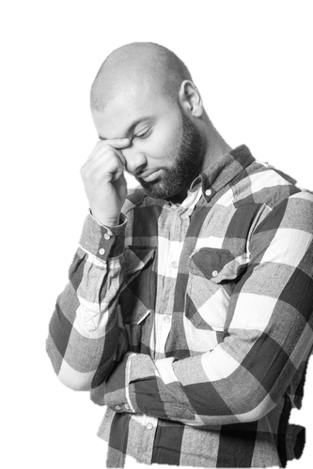
One DAI employee to another:
“I’m not going to say anything. You don’t disagree with that man.”
Notes:
Goal of this scenario is to get people talking about a possible code of conduct issue in which a supervisor does not tolerate dissent. The concern is that employees may not feel comfortable raising management or ethical issues to their supervisor. Provide them with responses they can use / possible next steps when faced with a situation like this.
Read out loud (or ask for a volunteer to read out loud) the scenario on the screen
Ask the large group to respond to the scenario:
Do you think there is an issue here?
How would you respond?
What would you do next?

Slide 13

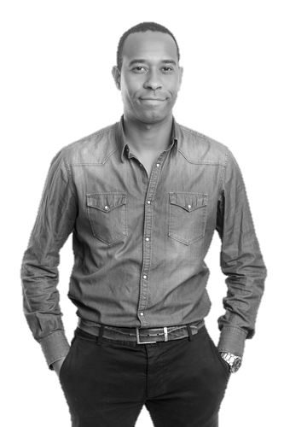
Client Representative:
“I’d like you to consider hiring Mr. Smith for the lead position. I worked closely with him for many years, so I’m familiar with his work and trust him with this important work.”
Notes:
Goal of this scenario is to get people talking about a possible ethical violation in that the client is directing DAI to hire someone. Provide them with responses they can use / possible next steps when faced with a situation like this.
Read out loud (or ask for a volunteer to read out loud) the scenario on the screen
Ask the large group to respond to the scenario:
Do you think there is an issue here?
How would you respond?
What would you do next?

Slide 14


Supplier:
“The tools I’m delivering are the same as the sample I gave you with the bid! Go ahead and check! I need to get paid soon though. Will $50 speed this up? Besides, who is going to check once the tools are distributed?”
Notes:
Goal of this scenario is to get people talking about a possible kickback or bribe. Provide them with responses they can use / possible next steps when faced with a situation like this.
Read out loud (or ask for a volunteer to read out loud) the scenario on the screen
Ask the large group to respond to the scenario:
Do you think there is an issue here?
How would you respond?
What would you do next?

Slide 15
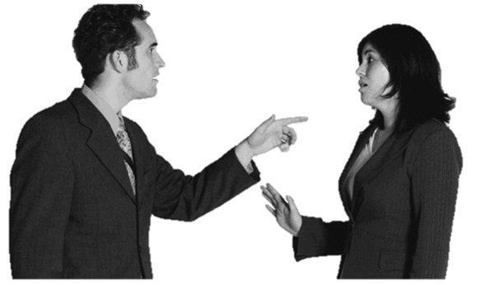
Supervisor:
“You are late AGAIN!! I don’t want to hear it. There is NO EXCUSE!!”
Notes:
Goal of this scenario is to get people talking about respect in the workplace and let them think about how to respond.
Read out loud (or ask for a volunteer to read out loud) the scenario on the screen
Ask the large group to respond to the scenario:
What are you concerns here?
How would you respond?

Slide 16
Scenarios

Slide 17
Instructions
Your Session Leader will place you in small groups and provide you with 1-2 scenarios
In your group, read through the scenarios and discuss the questions at the bottom
Be prepared to present back to the larger group about your scenarios and your responses to the questions
20 minutes
10 minutes / group
Notes:
Split larger group in to 2-4 smaller groups (at least 3 in a group)
Provide 1-2 case studies per group (printed out from this guide)
Print out enough copies ahead of time
Participants review Case Study and use the questions at the bottom of each Case Study to discuss
Session leader version of the case studies has direction on what types of answers you should be looking for from the discussion questions
Each group reports back to the larger group on their discussion (highlights of Case Study, group responses to questions, etc)
Repeat step 4 until all case studies have been discussed.

